Slide 1

FETAL HEALTH PREDICTION USING MACHINE LEARNING ALGORITHMS
Mentor: N.Shilpa Team Members: B.Theja 2105A41121
D.Charan Teja 2105A41124
M.Vishwanath 2105A41129
P.Sai Abhinay 2105A41130

Slide 2
Introduction
Fetal health monitoring is essential to ensure a baby’s well-being during pregnancy. Early detection of complications allows timely medical intervention, reducing the risks for both the mother and the baby.
Cardiotocography(CTG) is a widely used method that records Fetal Heart Rate (FHR) and Uterine Contractions to assess fetal condition. It helps doctors monitor fetal well-being and detect potential distress.
A fetus is an unborn baby, developing in the womb from the embryo stage until birth. CTG provides real-time data, making it easier for doctors to assess the mother's and baby's health conditions. By using this CTG it is more easy for the doctor to analyse the health condition of the women. We can easily generate data used by the doctor through CTG.
Every year, around 700 women die due to pregnancy-related complications. ML-powered CTG analysis can help reduce this number by improving early detection and intervention.
Machine Learning in Healthcare revolutionizes fetal health monitoring, providing automated, accurate, and faster analysis of CTG data. This assists doctors in making better decisions, ultimately reducing pregnancy-related risks and improving maternal and fetal health outcomes.

Slide 3

Problem Identification
Risk of Fetal Distress
Fetal distress is a critical condition where a baby experiences complications in the womb, often due to oxygen deprivation or abnormal heart rates. If left undetected, it can lead to:
Stillbirth - Loss of the baby before birth. Emergency C-sections - Unplanned surgical deliveries to save the baby and mother. Long-term health issues - Neurological damage due to prolonged distress.
Early detection of fetal distress is crucial for ensuring timely medical intervention and a safe delivery.
Imbalanced Fetal Health Cases
One major challenge in fetal health prediction is the imbalance in CTG recordings:
Most cases belong to healthy fetuses, making it harder to detect high-risk conditions.
Fewer suspect and pathological cases make traditional models less effective in predicting fetal distress.

Slide 4
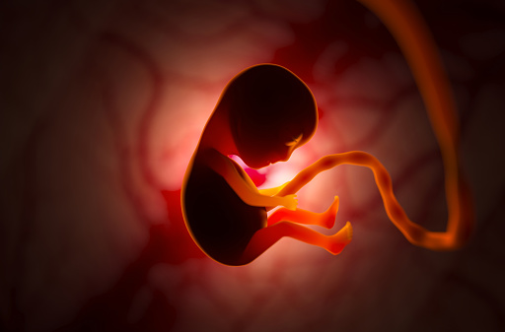
Defining Objective of the Problem
The primary objective of this problem is to utilize machine learning models to predict fetal health outcomes based on various physiological parameters.
Data Analysis:
By analyzing data such as baseline value, accelerations, fetal movement, uterine contractions, decelerations, and other key metrics, the goal is to accurately classify fetal health into categories such as Normal, Suspect, and Pathological.
Support for Healthcare Professionals:
This predictive capability aims to support healthcare professionals in early diagnosis and intervention, ultimately improving prenatal care and health outcomes for both mother and child.

Slide 5

Dataset Overview
The dataset contains 6000 rows and 22 columns of fetal health data collected from Cardiotocograms (CTG), a test used to monitor fetal well-being.
It includes 21 features and target variable related to fetal heart rate (FHR), uterine contractions, and variability measures that help assess fetal health.
The target variable fetal_health is classified into three categories: ✅ Normal (1) – Healthy fetus (4635 cases) ⚠️ Suspect (2) – Requires monitoring (855 cases) 🚨 Pathological (3) – High-risk fetus (510 cases)
The dataset is imbalanced, meaning most cases belong to the "Normal" category, making it harder to detect "Suspect" and "Pathological" cases.
The data helps train Machine Learning Models to predict fetal health and assist doctors in early detection of fetal distress.

Slide 6
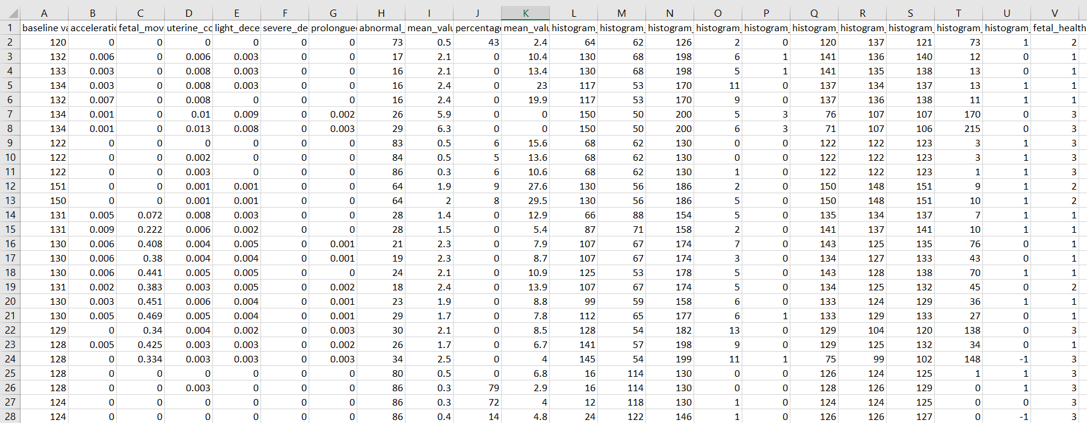
Dataset

Slide 7
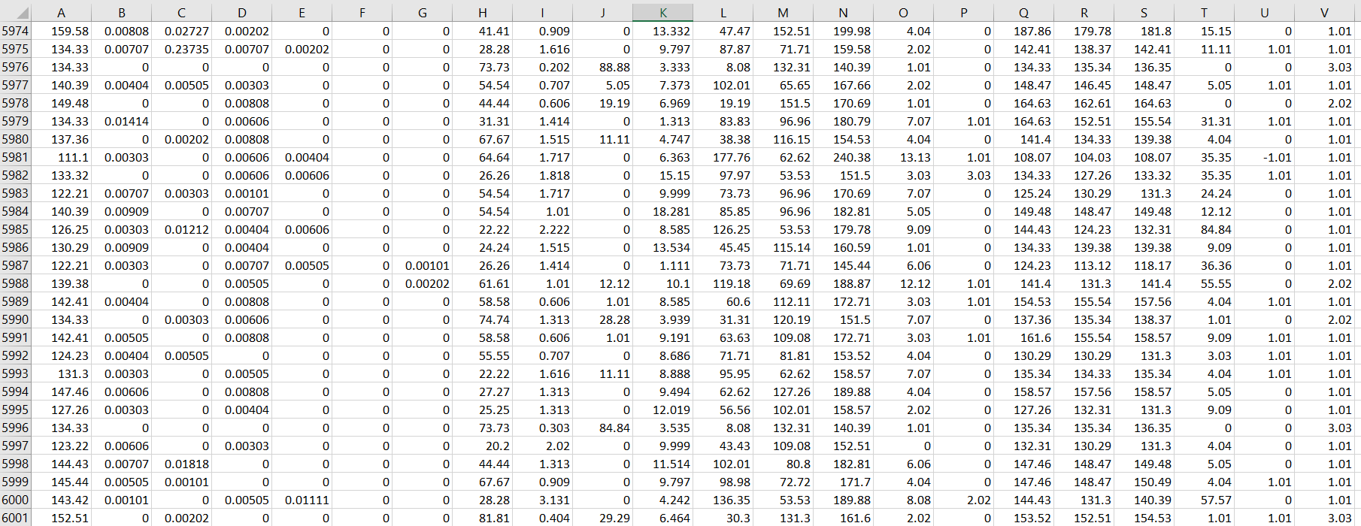
Dataset

Slide 8

Features
Histogram Variance
Histogram Median
Histogram Mean
Histogram Mode
Histogram Tendency
Histogram number of zeros
Histogram number of peaks
Histogram Max
Histogram Min
Histogram width
Percentage of time with abnormal long term variability
Mean value of short time variability
Mean value of long time variability
Abnormal short time variability
Prolonged decelerations
Severe decelerations
Light decelerations
Uterine contractions
Fetal movement
Accelerations
Baseline value

Slide 9
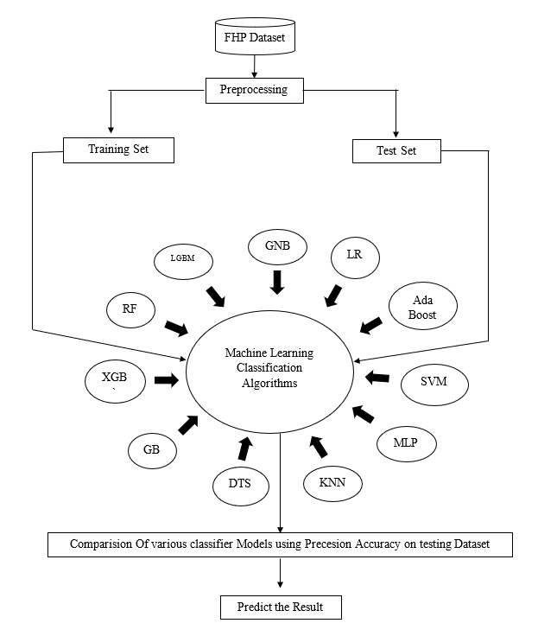
Flowchart
The process begins with the Fetal Health Prediction (FHP) dataset, containing fetal heart rate (FHR) and uterine contraction data.
Data preprocessing is performed to clean, scale, and prepare the dataset for training and testing.
The dataset is split into Training Set (for model training) and Test Set (for model evaluation).
Various machine learning classification algorithms are applied to predict fetal health.
The classification models used include Random Forest (RF), XGBoost (XGB), Gradient Boosting (GB), LightGBM (LGBM), Decision Tree (DTS), K-Nearest Neighbors (KNN), Gaussian Naïve Bayes (GNB), Logistic Regression (LR), AdaBoost, Support Vector Machine (SVM), and Multi-Layer Perceptron (MLP).
Model performance is evaluated by comparing precision and accuracy on the test dataset.
The best-performing model is selected for final fetal health prediction and medical decision support.

Slide 10
Workflow
1. Dataset Selection
Select a dataset containing fetal health data (e.g., Cardiotocography dataset).
2. Data Preprocessing
Handle missing values (if any).
Apply feature engineering techniques such as normalization and standardization.
3. Exploratory Data Analysis (EDA)
Perform statistical analysis on features.
Visualize distributions using histograms, box plots, and correlation heatmaps.
4. Feature Selection
Use techniques like SelectKBest, Recursive Feature Elimination (RFE), or PCA to retain the most relevant features.
5. Data Splitting
Split data into training, validation, and test sets (e.g., 70%-15%-15%).
6. Model Optimization
Train machine learning models such as:
LightGBM (LGBM)
XGBoost Classifier
Support Vector Machine (SVM)
Random Forest
Logistic Regression
Tune hyperparameters using Grid Search or Bayesian Optimization.
7. Model Evaluation
Accuracy
Precision
F1 Score
Recall
8. Final Model Evaluation
Compare all models based on accuracy.
Select the best-performing model for fetal health prediction.
Assess models using metrics like:

Slide 11
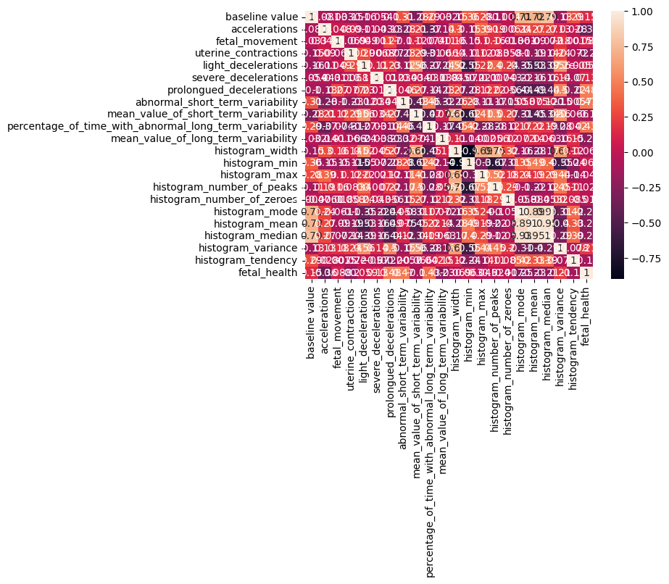
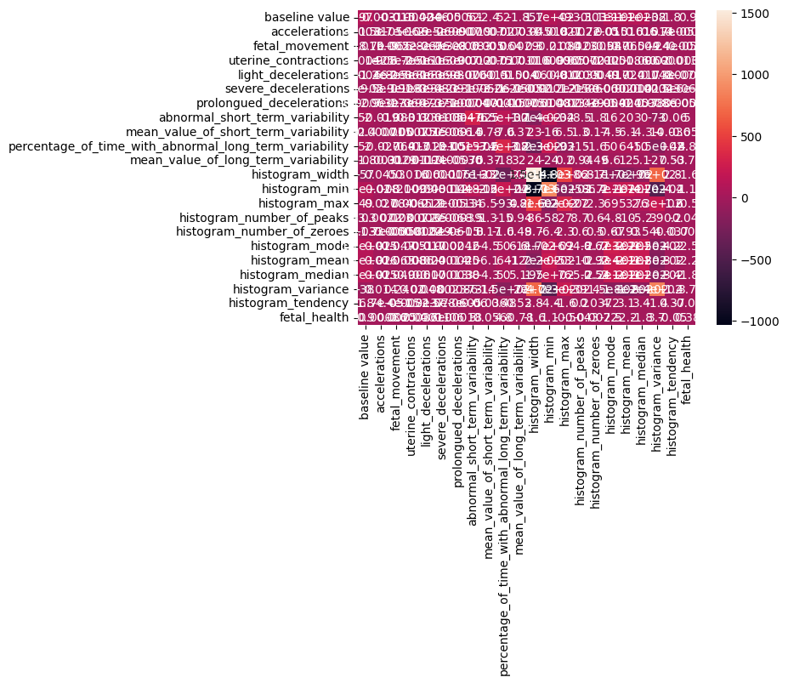
Correlation VS Covariance Matrix
Correlation Matrix
Covariance Matrix

Slide 12
Algorithms and Metrics
The algorithms which we used based on the research we have conducted to handle imbalanced data and to achieve high accuracy are:
ML Algorithms | Data Preprocessing Techniques | Model Evaluation Metrics
LightGBM (LGBM) | Data Cleaning | Accuracy
Gradient Boosting (GB) | Feature Engineering | Precision
XGBoost (XGB) | Feature Selection | Recall
Random Forest (RF) | Data Scaling | F1 Score
Decision Tree Classifier | Handling Class Imbalance | ROC AUC
K-Nearest Neighbors (KNN) | Normalization | Sensitivity & Specificity
AdaBoost | Outlier Detection | Balanced Accuracy
Support Vector Machine (SVM) | Feature Transformation | MCC (Matthews Correlation Coefficient)
Multi-Layer Perceptron (MLP) | Data Augmentation | Log Loss
Logistic Regression | Standardization | Brier Score
Gaussian Naïve Bayes (GNB) | Handling Missing Values | Cohen’s Kappa

Slide 13
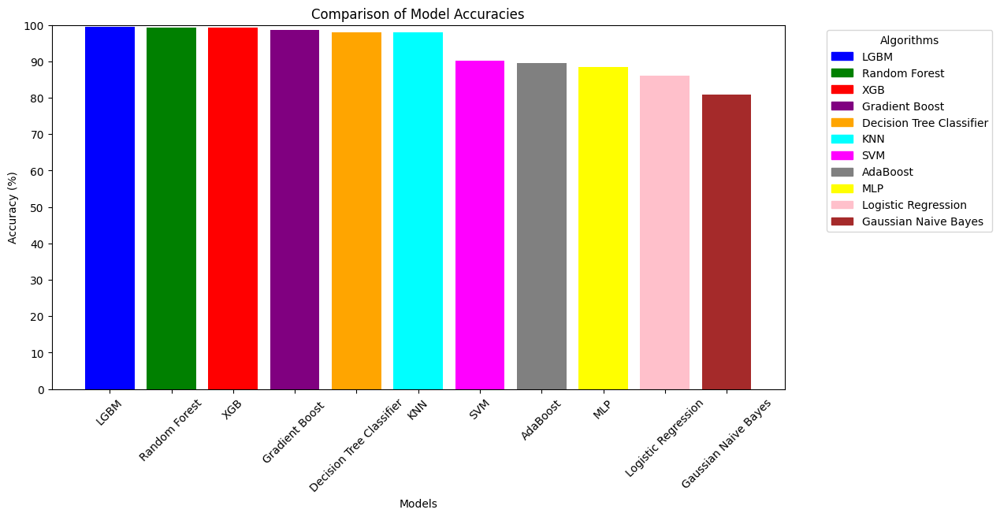
Comparison of Algorithms
The bar chart provides a visual comparison of the performance of various machine learning algorithms

Slide 14
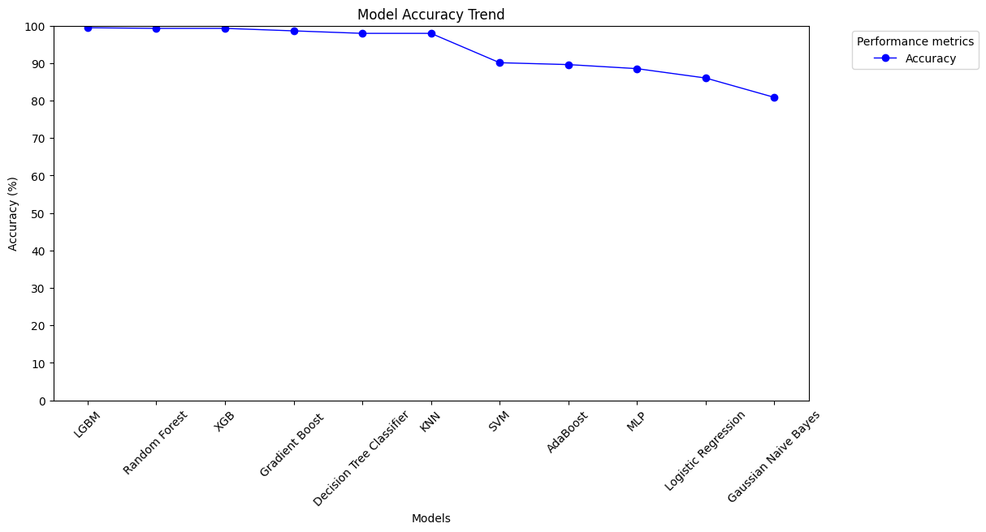
Accuracy Trend
Ensemble models (LightGBM, XGBoost) achieve the highest accuracy in fetal health prediction, while traditional models (Logistic Regression, Naive Bayes) perform lower.

Slide 15
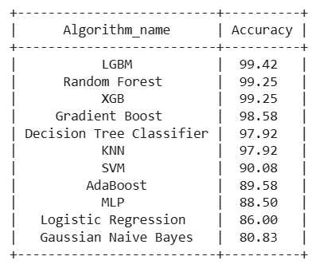
Acquired Results

Slide 16
Conclusion
Fetal Health Prediction using machine learning enables early detection of risks, leading to timely medical intervention and improved pregnancy outcomes.
By evaluating multiple algorithms such as LGBM, Gradient Boost, XGB, Random Forest, Decision Tree Classifier, KNN, AdaBoost, SVM, MLP, Logistic Regression, and Gaussian Naive Bayes, we identified LGBM as the most accurate model with 99.42% accuracy, followed by Gradient Boost and XGB.
This study highlights the significance of analyzing CTG data to classify fetal health effectively. The results provide valuable insights for healthcare professionals, supporting them in making faster and more accurate decisions to safeguard both mother and child.
Ethical concerns, including patient privacy and responsible use of medical data, remain crucial to ensuring the safe deployment of AI-driven healthcare solutions.

Slide 17
Thank You

